Slide 1

TECHNOLOGICAL INSTITUTE OF THE PHILIPPINES
College of Information Technology Education
Write Your First C++ Program

Slide 2
Intended Learning Outcomes (ILOs)
At the end of the lesson the students should be able to:
Examine the programming process of C++.
Explore how to properly structure a C++ program.
Learn how to write a C++ program.
Learn how to debug syntax error.

Slide 3
Compiling and Linking the Source Code
Before you create your first C++ program, It’s worthwhile to understand the process.
C++ programs begin as source code files that can be given filenames ending with the extensions .cpp, cxx, .cp or .c. Our C++ source code files with the .cpp extension which is the most common choice for C++ programmers and the default for some compilers.
Source Code is the human-readable form of a C++ program. It can’t be run until it is compiled and linked.
After your source code is compiled, an object file is produced. This file is turned into an executable program by a linker.
C++ programs are created by linking together one or more object files with one or more libraries.
A Library is a collection of linkable files that provide useful functions and classes that you can rely on in your programs. A function is a block of code that performs a task, such as multiplying two numbers or displaying a text. A class is the definition of a new type of data and related functions.

Slide 4
Source Code / Source File
WRITE
SAVE
COMPILE
RUN

Slide 5
Creating Your First C++ Program
Now that you’ve been introduce to the process, it’s time to create your first C++ program!!!
Here are the steps to create a C++ program:
Open the Dev C++ Compiler (Compiler- The essential tools needed to follow these tutorials are a computer and a compiler toolchain able to compile C++ code and build the programs to run on it) . Dev C++ - is a free Integrated Development Environment (IDE) compiler for Windows platform
Open New SourceFile ,go to File-> New -> Source File
Write the following C++ code and save the file as firstprogram.cpp (File -> Save File as)
// firstprogram.cpp
#include <iostream> using namespace std; main() { cout << "Hello World!"; }
4) Save, Comple and Run
5) Display the output 0r Error

Slide 6

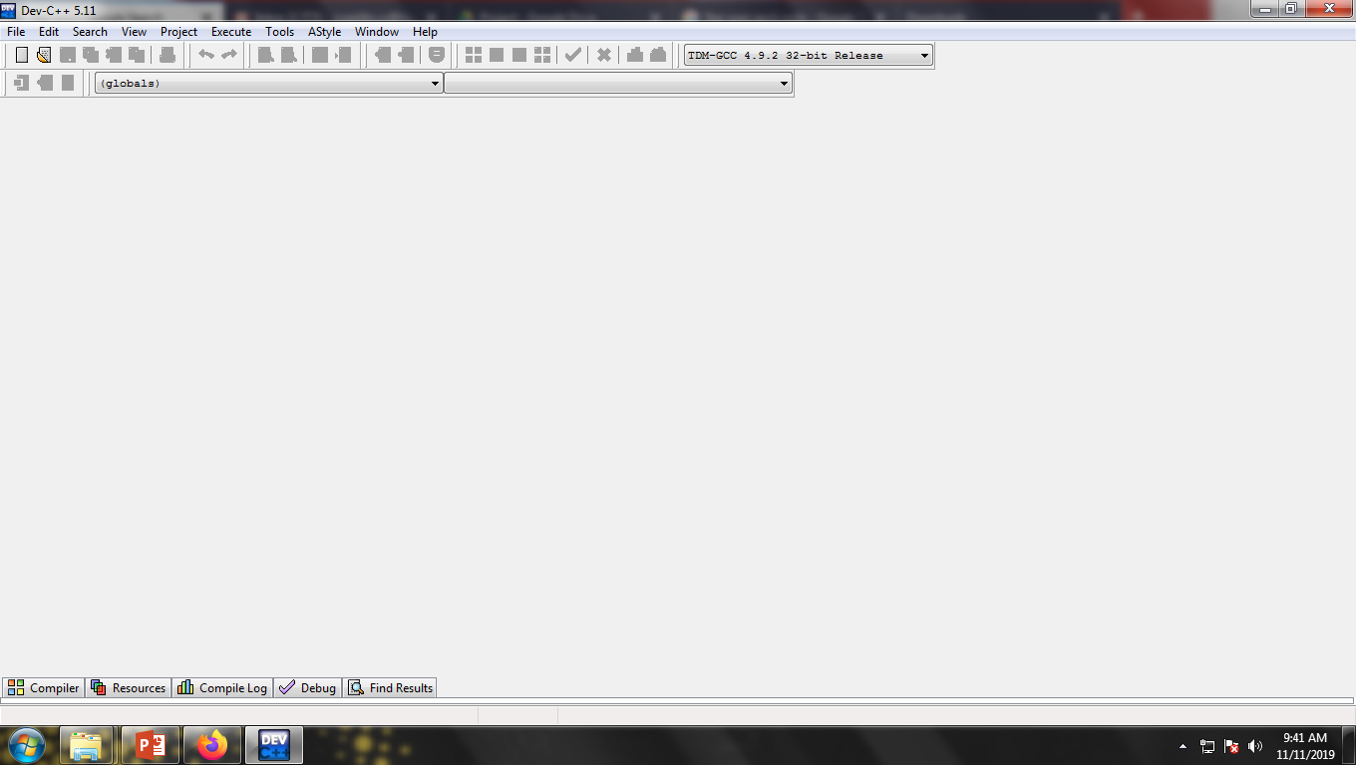
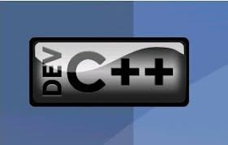
STEPS IN CREATING C++ PROGRAM
Open the Dev C++ Compiler
Dev C++ - is a free Integrated Development Environment (IDE) compiler for Windows platform.

Slide 7
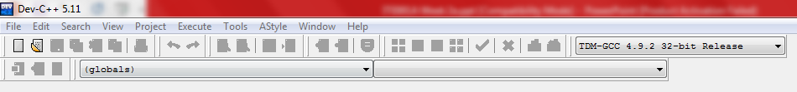
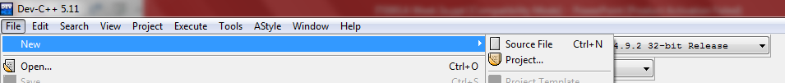

STEPS IN CREATING C++ PROGRAM
2)Open New Source File ,go to File-> New -> Source File
CTRL + N

Slide 8
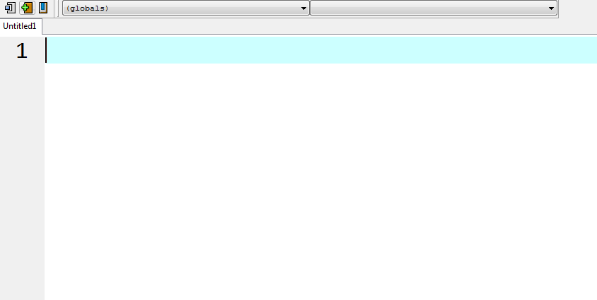
STEPS IN CREATING C++ PROGRAM
Workspace – write your program here
3)Write the following C++ code and save the file as firstprogram.cpp (File -> Save File as)
// firstprogram.cpp
#include <iostream> using namespace std; main() { cout << "Hello World!"; }

Slide 9

STEPS IN CREATING C++ PROGRAM
4) Save, Compile and Run
5) Display the output or Error
Press F11

Slide 10
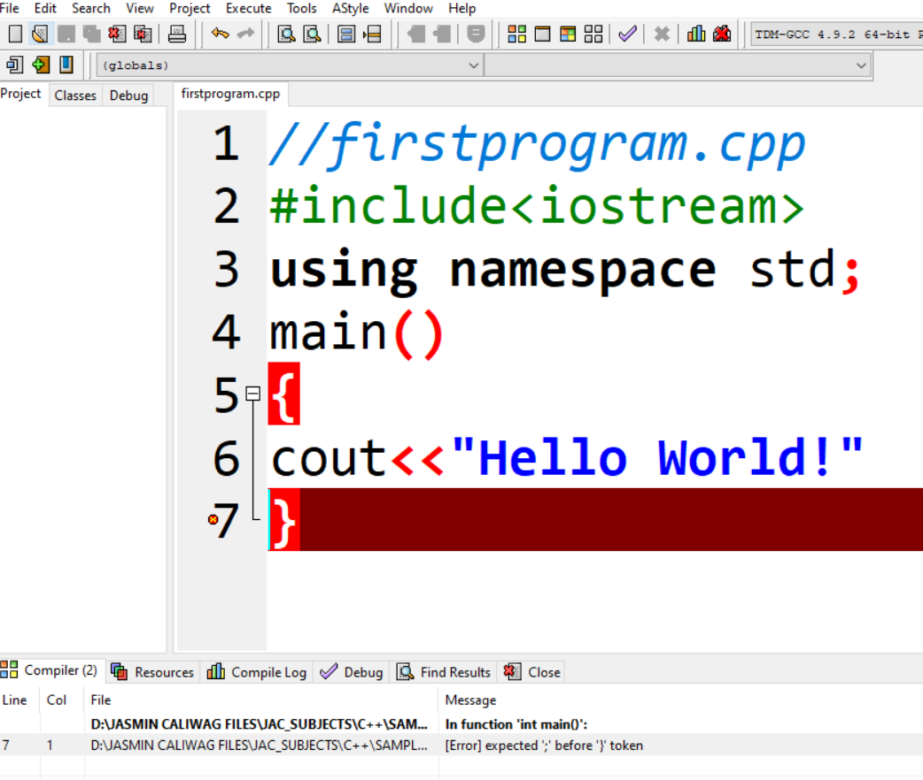
Sample Errors / Bugs
Did you see the error?
[Error] Expected ‘;’ before ‘}’ token
What is the error of the program?
NO SEMICOLON (;) AFTER THE “”

Slide 11
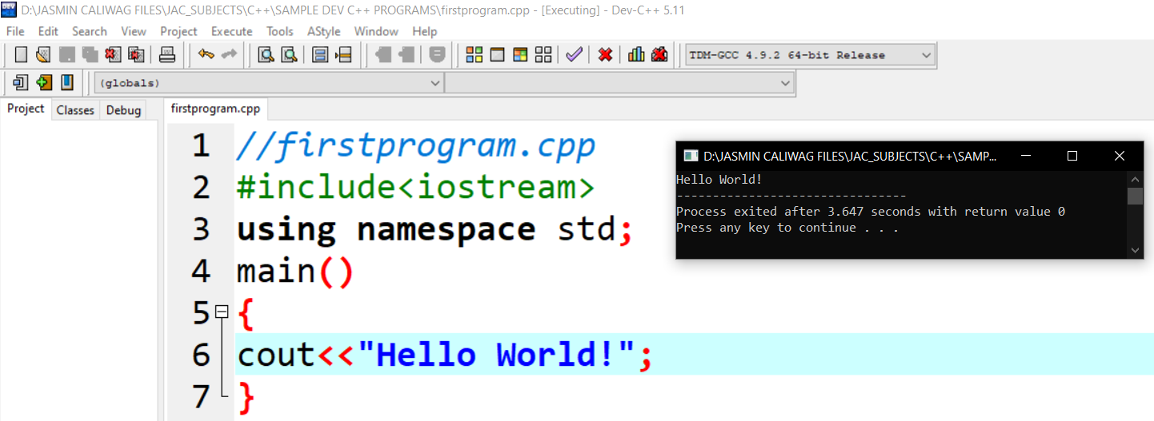
Write your first program

Slide 12
Structure of a Program
1 //My first Program in C++
2 #include <iostream>
3 using namespace std;
4 main()
5 {
6 cout << "Hello World!";
7 }
OUTPUT:
Hello World!

Slide 13
Structure of a Program
Let's examine this program line by line:
Line 1: // my first program in C++
COMMENT- there are two types of comments
(a) Single-line Comment- starts with the pair of symbols // .Two slash signs indicate that the rest of the line is a comment inserted by the programmer but which has no effect on the behavior of the program.
Ex. // my first program in C++
(b) Multiple-line Comments - enclosed between /* and */. The compiler ignores anything that appears between the comments.
Ex. /* My first Program
in C++ Programming */

Slide 14
Structure of a Program
Let's examine this program line by line:
Line 2: #include <iostream>
Header file library that lets us work with input object (cin function) and output object (count function)
Lines beginning with a hash sign (#) are directives read and interpreted by what is known as the preprocessor. They are special lines interpreted before the compilation of the program itself begins.
In this case, the directive #include <iostream>, instructs the preprocessor to include a section of standard C++ code, known as header iostream, that allows to perform standard input and output operations, such as writing the output of this program (Hello World) to the screen.

Slide 15
Structure of a Program
Line 3: using namespace std;
Which indicates to the system where the standard library is.
“std” is an abbreviation for standard. If this namespace is not used, then computer finds for the cout, cin and endl etc.. Computer cannot identify those and therefore it throws errors.
It means that we can use names for objects and variables from the standard library
**Don’t worryif you don’t understand how #include<iostream> and using namespace std; works . Just of it as something that these are always/required in your program.

Slide 16
Structure of a Program
Line 4: main ()
This line initiates the declaration of a function- a group of code statements which are given a name: in this case, this gives the name "main" to the group of code statements that follow.
The function named main is a special function in all C++ programs; it is the function called when the program is run. The execution of all C++ programs begins with the main function, regardless of where the function is actually located within the code.

Slide 17
Structure of a Program
Lines 5 and 7: { and }
The open brace ({) at line 5 indicates the beginning of main's function definition, and the closing brace (}) at line 7, indicates its end. Everything between these braces is the function's body that defines what happens when main is called. All functions use braces to indicate the beginning and end of their definitions.

Slide 18
Structure of a Program
Line 6: cout << "Hello World!";
This line is a C++ statement. A statement is an expression that can actually produce some effect. It is the meat of a program, specifying its actual behavior. Statements are executed in the same order that they appear within a function's body.
This statement has three parts:
First, cout, an object which identifies the standard character output device (usually, this is the computer screen).
Second, the insertion operator (<<), which indicates that what follows is inserted into cout to output/print text.
Finally, a sentence within quotes ("Hello world!"), is the content inserted into the standard output.
Notice that the statement ends with a semicolon (;). Every C++ statement ends with a semicolon.

Slide 19
Structure of a Program Summary
You may have noticed that not all the lines of this program perform actions when the code is executed.
There is a line containing a comment (beginning with //).
There is a line with a directive for the preprocessor (beginning with #).
There is a line that defines a function (in this case, the main function).
And, finally, a line with a statements ending with a semicolon (the insertion into cout), which was within the block delimited by the braces ( { } ) of the main function.

Slide 20
C++ Output (Print Text) using cout object
The cout object, together with << operator is used to output values/print text.
Example:
cout<<“hello world”;

Slide 21
C++ New Lines using \n and endl
Both \n and endl are used to break lines. However, \n is used more often and is the preferred way.
Every \n and endl break one line, so you can use one or more \n in your program
Note: endl format is << endl, operator << before the endl

Slide 22
Sample Program using new line \n and endl
Program : without using new line \n or endl
#include <iostream>
using namespace std;
main(){
cout << "Hello C++!";
cout << "Hello C++!";
cout << "Hello C++!";}
Modified Program
#include <iostream>
using namespace std;
main(){
cout << "Hello C++!“ << endl;
cout << "Hello C++! \n" ;
cout << “\nHello C++! " ;}
Program 2 : OUTPUT
Hello C++! Hello C++! Hello C++!
Modified Program 2 : OUTPUT
Hello C++!
Hello C++!
Hello C++!

Slide 23
Review: C++ Output (Print Text) using cout object with new line
Problem: Write a program that produces the following output using cout object.
CCCCCCCCC ++ ++
CC ++ ++
CC ++++++++++++++ +++++++++++++++++
CC ++++++++++++++ +++++++++++++++++
CC ++ ++
CCCCCCCCC ++ ++

Slide 24
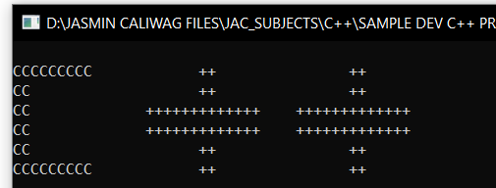
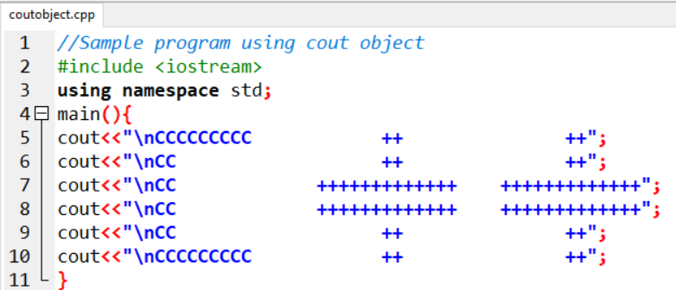
Review: C++ Output (Print Text) using cout object
ANSWER: The source code that answer the problem
OUTPUT

Slide 25

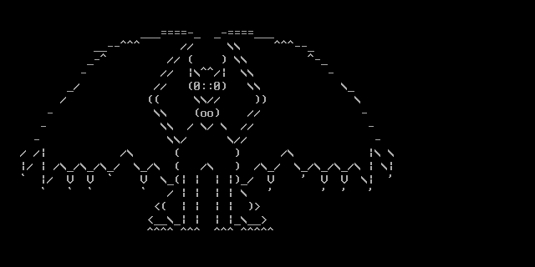
Sample Drawing using cout() function

Slide 26
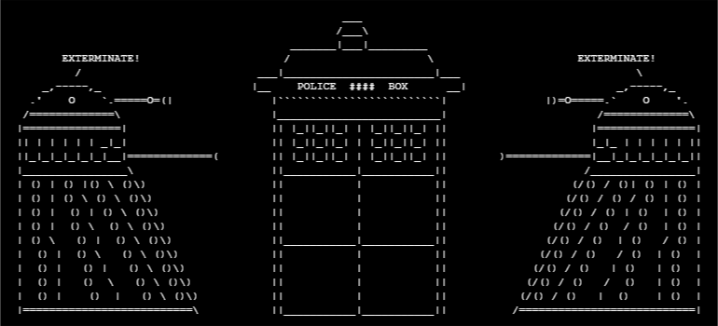
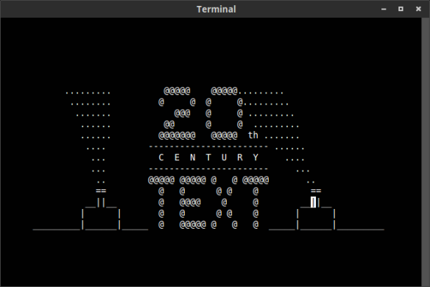
Other Sample Drawing using cout() function

